Slide 1
Rising Star Update
Lin, Yuchen, Chengxi
Sept 12, 2017

Slide 2
Agenda
Methodology: K-means (Lin)
Update (Yuchen)
Feature Selection (Yuchen)
Modeling (Chengxi)
Result and Validation (Chengxi)
Future Work

Slide 3
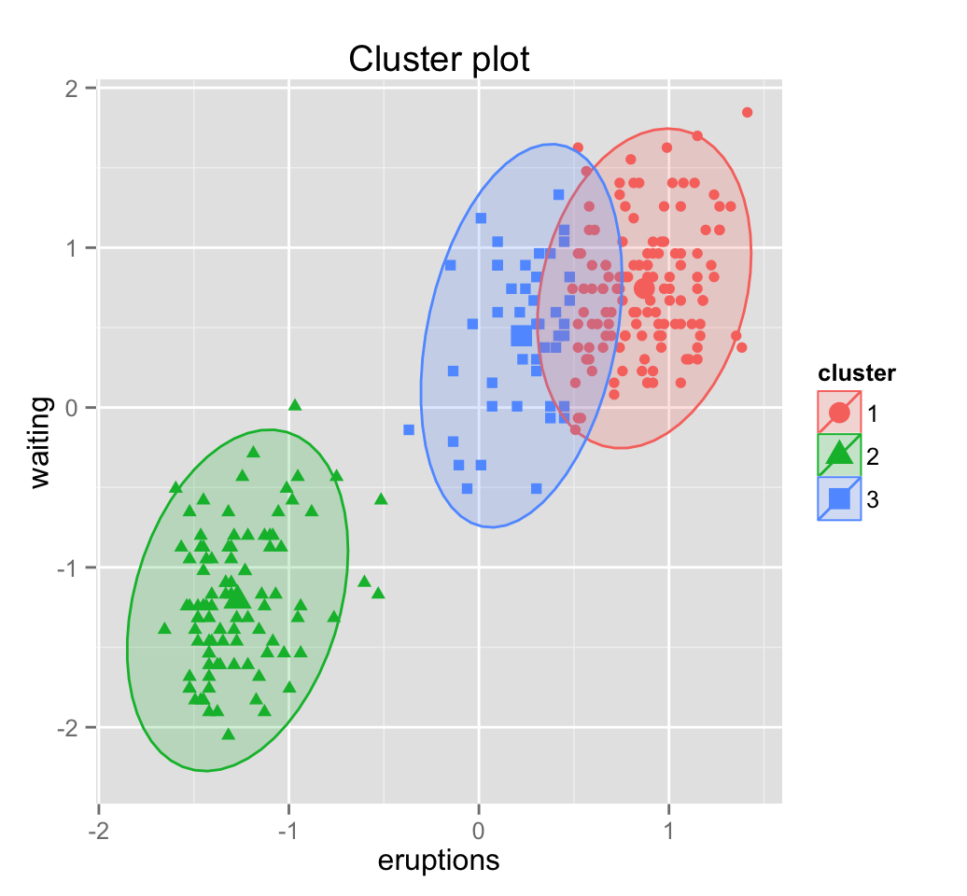
Methodology
KOL
Indices
Rising stars
Clustering Method: K-means
3 steps:
Define features
Train Model
Evaluation
Non-KOL
Indices
Notes:
Supervised learning is not applicable due to the absence of manually annotated data(rising stars) for this task

Slide 4
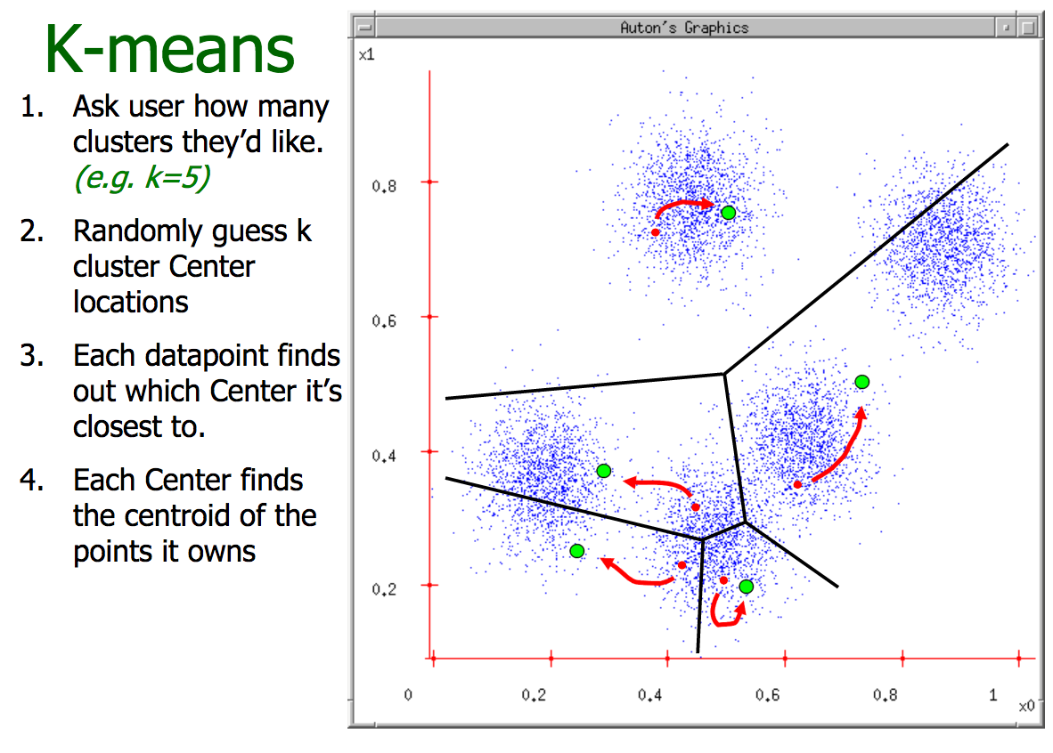
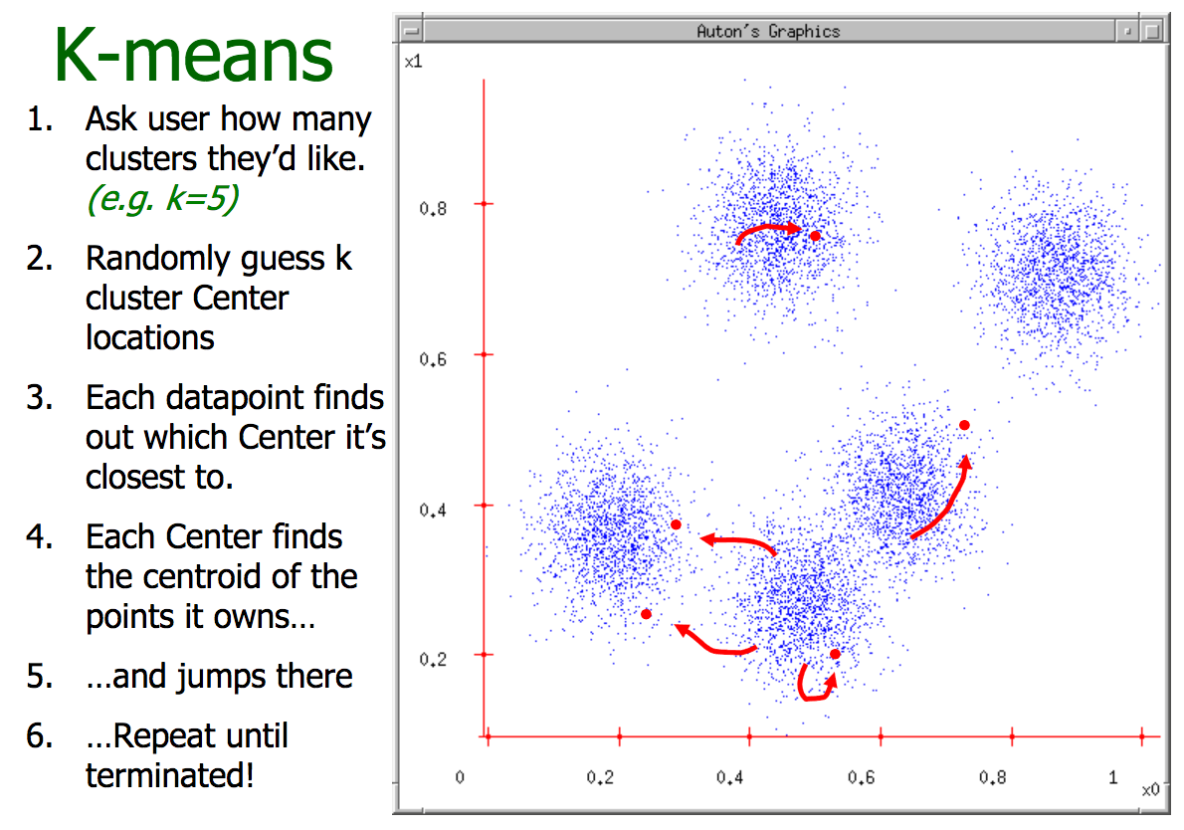
Introduction to K-means
http://www.cs.cmu.edu/~./awm/tutorials/kmeans11.pdf

Slide 5
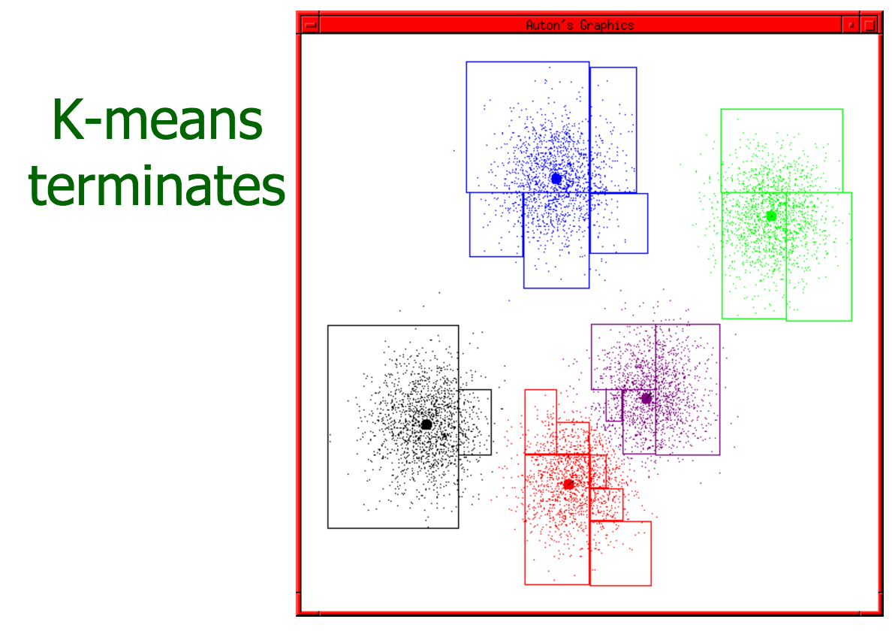
Introduction to K-means
http://www.cs.cmu.edu/~./awm/tutorials/kmeans11.pdf

Slide 6
Update
Rejected Google citation data due to copyright issue
Left with SJR feature alone (Scientific Journal Ranking)
Need to feed more features into model
One feature gets us nowhere in data science
Received more data regarding 600 individuals
Featured engineered:
Number of education
Weighted number of education based on institution reputation
Number of awards
Number of trials
Number of events (conference)
Number of press appeared (business wire etc.)

Slide 7
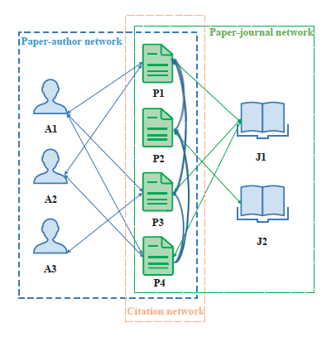
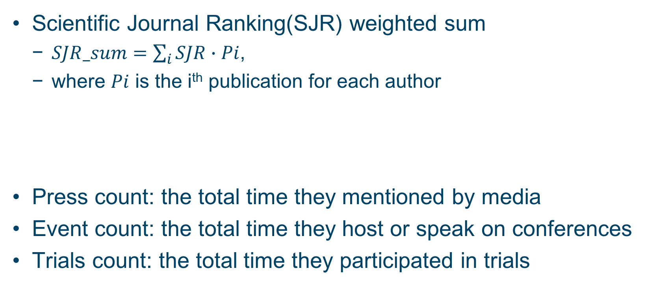
Feature Selection
Scientific Journal Ranking(SJR) weighted sum
$SJR_sum=\sum_{i}{SJR∙Pi}$,
where $Pi$ is the i^{th} publication for each author
Press count: the total time they mentioned by media
Event count: the total time they host or speak on conferences
Trials count: the total time they participated in trials

Slide 8
SJR over time
Year since first publication

Slide 9
K-means Modeling
Selecting the number of clusters using silhouette analysis
Silhouette analysis can be used to study the separation distance between the resulting clusters.
K = 5
K = 4
K = 3
K = 2
Samples close to decision boundary
Samples far away from neighboring clusters
0
1
0.50
0.55
0.58
0.64
http://scikit-learn.org/stable/auto_examples/cluster/plot_kmeans_silhouette_analysis.html

Slide 10
Results and Validation
Confusion matrix:
KOL = 1, Others = 0
N = 501 | Predict: 0 | Predict: 1
Annotated: 0 | TN = 362 | FP = 54
Annotated: 1 | FN = 30 | TP = 57

Slide 11
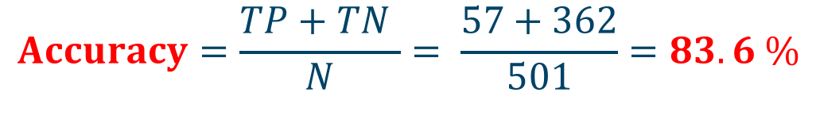
Results and Validation
Confusion matrix: KOL = 1, Others = 0
N = 501 | Predict: 0 | Predict: 1
Annotated: 0 | TN = 362 | FP = 54
Annotated: 1 | FN = 30 | TP = 57
$$Accuracy=\frac{TP+TN }{N}= \frac{57+362}{501}=83.6 \%$$

Slide 12
Results and Validation
Rising Star Definition: who is predict to be KOL but was not manually annotated, which is FP group in confusion matrix.
N = 501 | Predict: 0 | Predict: 1
Annotated: 0 | TN = 362 | FP = 54
Annotated: 1 | FN = 30 | TP = 57
Rising star(FP) = 54
Rising stars: FP = 54
Percentage of Rising Stars: 54/501 = 10.8%

Slide 13
Results and Validation

Slide 14
Results and Validation
ID | SJR score | press_count | event_count | trials_count
HBE_UR_00008 | 753.495 | 45 | 32 | 9
HBE_IDN_5002127 | 818.145 | 18 | 38 | 20
HBE_IDN_5002891 | 747.49 | 6 | 26 | 13
HBE_ONC_1002893 | 924.432 | 0 | 122 | 53
HBE_ONC_1000504 | 752.811 | 0 | 61 | 46
HBE_ONC_1000509 | 950.315 | 0 | 40 | 42
HBE_IDN_5002200 | 779.395 | 0 | 32 | 38
7 rising stars according to our model

Slide 15
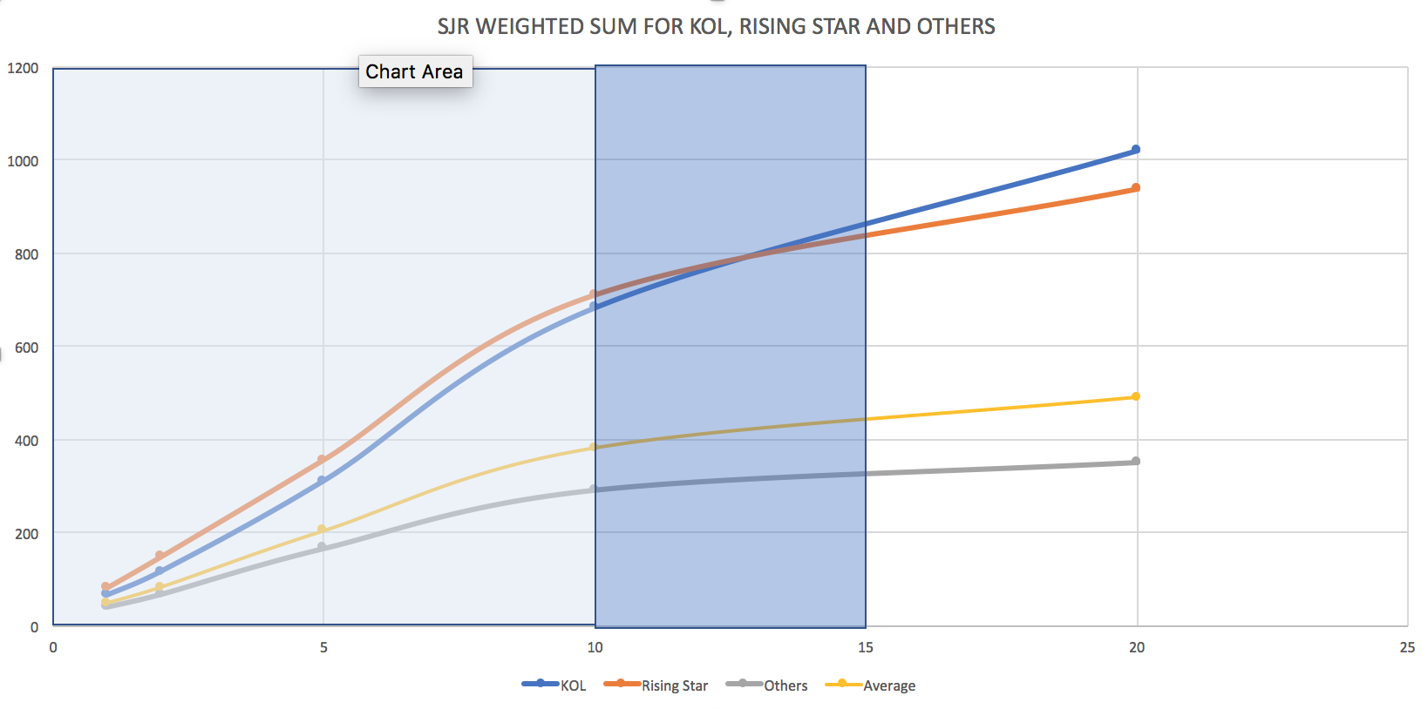
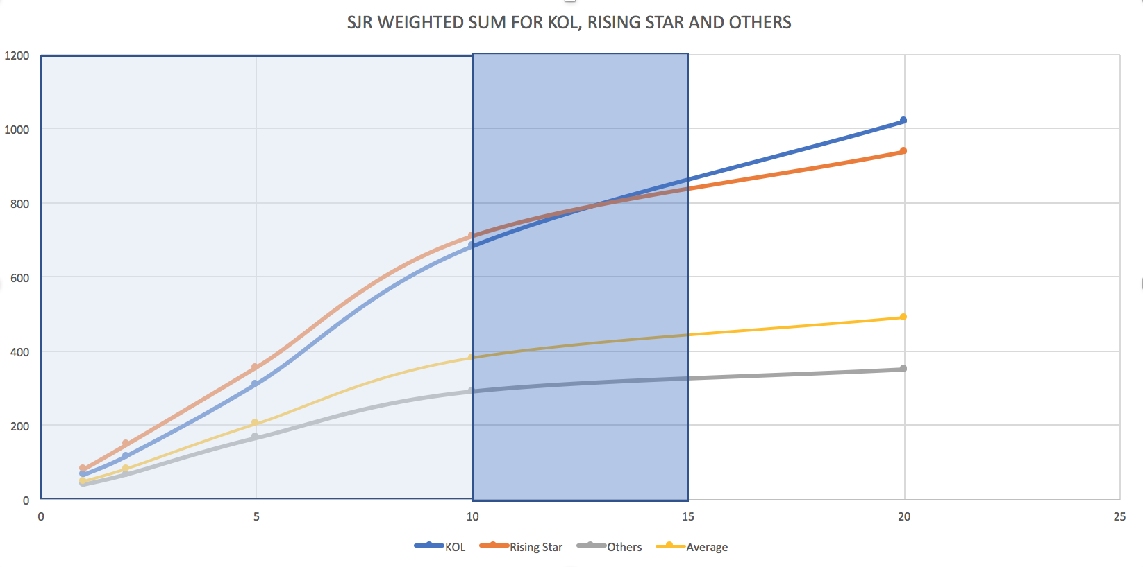
Results and Validation
Year since first publication

Slide 16
Future Work
Fine tune the model :
author position in publication
linkage to existing 100 KOLs
Improve model accuracy with access to publication-wise citation data with potential funding

